Slide 1
Giraffes vs Fighter pilots

Slide 2
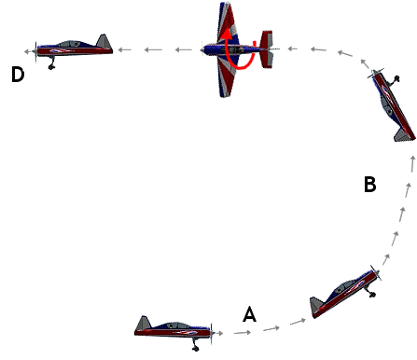
High +Gz acceleration for fighter pilots

Slide 3
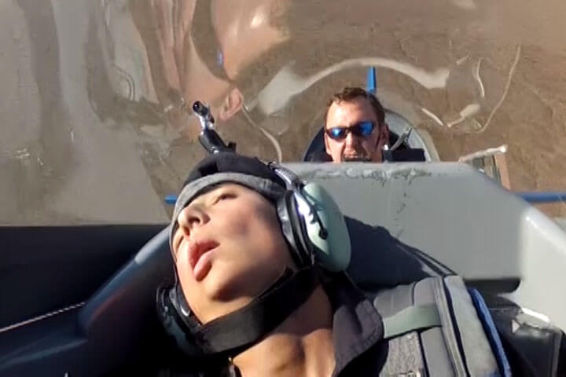
Dangers
Cranial hypotension
Alternation to cardiovascular system
Impair cerebral blood flow
Impair visual ability
G-induced loss of consciousness

Slide 4
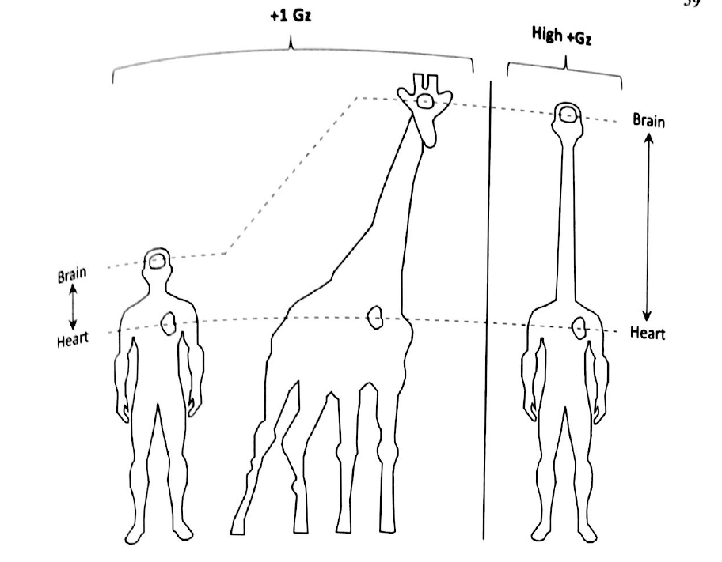
Giraffe
Long neck -> huge hydrostatic force
Same as pilots when they lifting head
However they will NOT faint

Slide 5
Intraocular pressure drops
Hydrostatic pressure = fluid density x acceleration x height of fluid colume
Normally: +1Gz, 30 cm between head and heart -> 22 mmHg
+2Gz => 44 mmHg, +4Gz -> 88 mmHg, worse when heart is lowered
Drops
15 mmHg -> Visual impairment
More -> Temporary unconsciousness

Slide 6
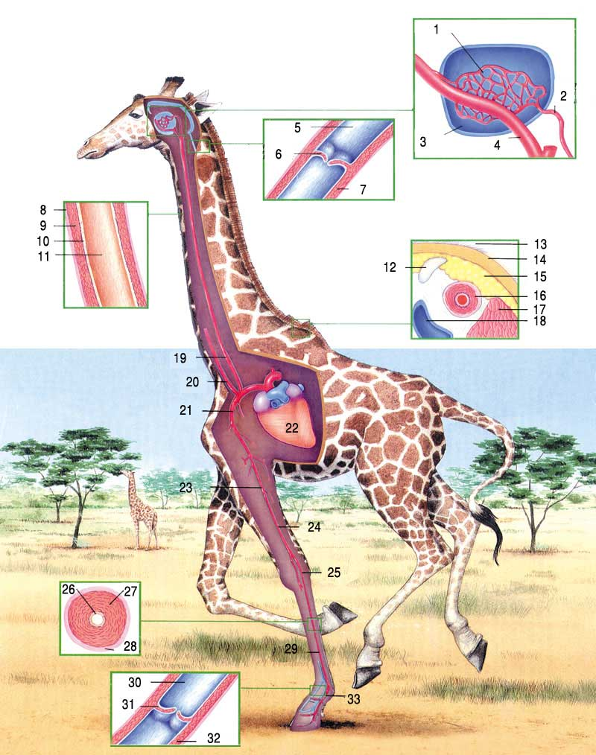
Giraffe’s circulatory adjustments
+4Gz for human = +1Gz for giraffe
Maintain an optimal cerebral perfusion pressure (CPP)
Thick arterial walls and abundant connective tissues
-> overcome 118mmHg
Valves in neck veins to prevent backflows of blood
into brain
Non-collapsible ‘venous’ drainage channel to
enhence CPP
Legs are thin and the skin is non-distensible
-> countermeasures

Slide 7
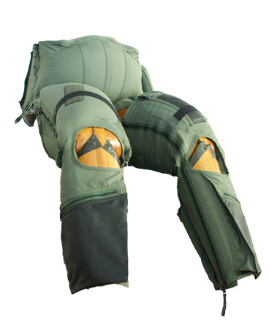
Lessons to be learned for the pilots
Arterial pressure at head level must be maintained
Anti-G Straining Maneuver, AGSM
Principle method for more than +5Gz
Tensing leg, arm and abdominal muscles
Anti-G suit
Pressurized with air to press the legs and abdominal region
Create vasoconstriction
Heart is elevated upward
Pressure breathing
Wear a jerkin which is inflated to the same pressure as the mask
counteract the high levels of pressures required

Slide 8
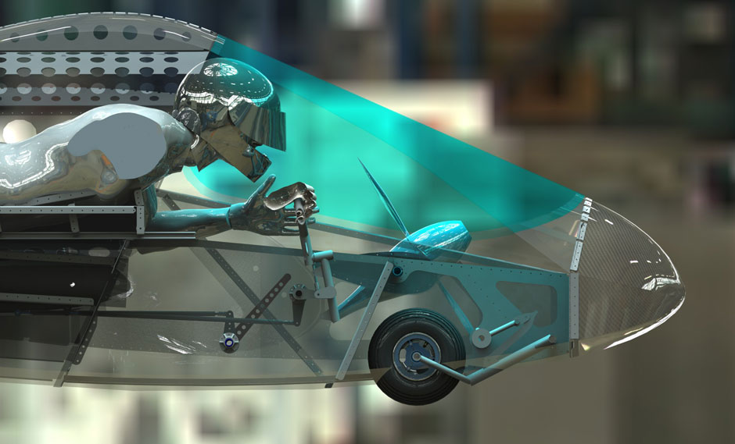
More lessons
Muscular strength training
10 – 12 weeks weight lifting
-> increase 50% G-duration tolerance
Postural modification
Decrease the vertical distance
between brain and heart of the pilot
F-16 fighter -> 30-degree seatback angle
EMG-5 with prone position

Slide 9
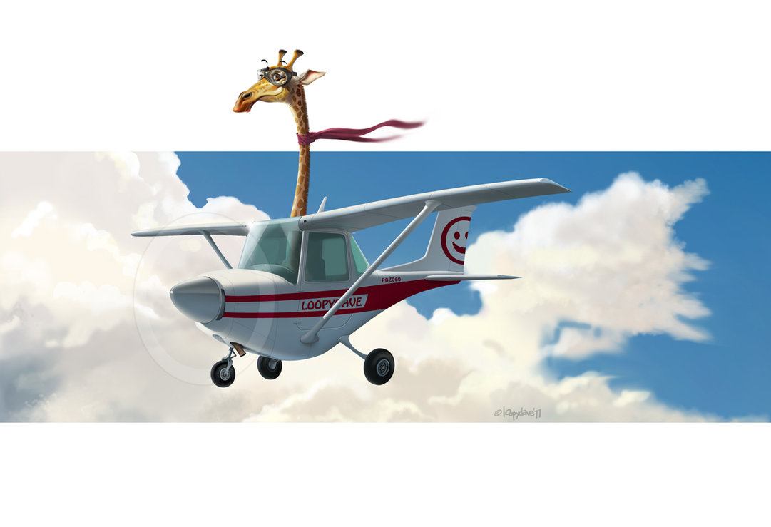
Conclusion
The pilots partially mimics some natural anatomical features of the giraffes
AGSM -> increase arterial pressure at heart level
Anti-G suit -> works like giraffe’s legs and skin
Giraffe should not fly!

Slide 10
Thank you very much!

